Slide 1
DISRupting STRESS, Managing TRAUMA
The Five Senses

Slide 2
STRESS: What’s HAPPENING IN OUR BODY?
Hypothalamus: Fight or Flight
Adrenaline: Increases heart rate and blood pressure
Cortisol: Increases energy, suppresses other body functions

Slide 3
Touch
Baoding Balls
Two Brain Channels: A sensory channel (sight, sound, feel, and smell) and an intellectual channel (create context)
Stress balls: Blocking the sensory channel

Slide 4
Sight

Slide 5
TASTE
70% = Stress Reduction (The Power of the Flavanoid)
Boost to Mood, Memory, and Immune System

Slide 6
SMELL
Crossing the blood-brain barrier
Immediate Bodily Changes
Peppermint’s Magic: Menthol

Slide 7
Sound
Dopamine, the Happy Chemical
Changes brainwave length
The World’s Fourth-Most Relaxing Song

Slide 8
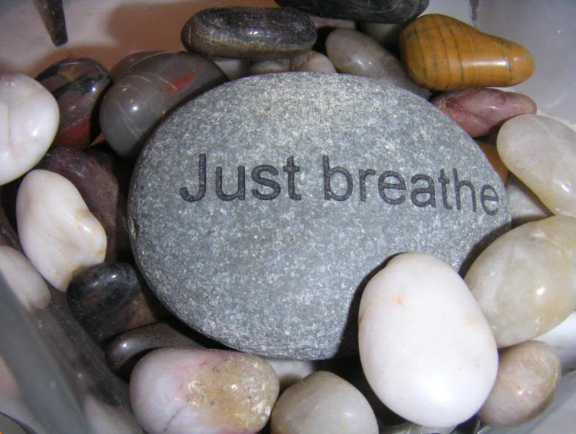
Bonus Sense: Breath
Belly Breathing
Cognitive Break + Biological Brake

Slide 9
“The most important strategy in your personal life is to have one.”

